Slide 1

TMDB Movie Data Analysis -using Python
Unlocking Insights for Commercial Success
Vaibhav Sirohi
Batch:DA92S9

Slide 2

Business objective
To analyze movie performance cinemas.
To find the insights that help to increase the movie commercial success.
To help movie makers make smart choices about budgets, revenue, genres, and strategies for creating successful movies.

Slide 3

Introduction
Welcome to the presentation on TMDB Movie Data. In this presentation, we will explore the summarization Data-Driven Insights, visualization for Insights and will understanding the main characteristics of a dataset that how a Production Company Make Informed Decisions related to Movie Information, Ratings, Genres, Budget, Revenue, etc.
Highlight Importance of Data-Driven Decision-Making ,Data Cleaning, Data Exploration, Insights Generation and extracting meaningful insights from dataset

Slide 4



Table of Content
TMBD MOVIE ANALYSIS PROJECT
Task 1: Load the movie dataset in the Python notebook. Display the numbers of rows and columns in the dataset. Display the titles and genres of the first 50 movies from the dataset.
Task 2: Identify the columns that have null values and perform the null value treatment. (Choose the imputation method based on the type of data in the columns of interest)
Task 3: Display the movie categories that have a budget greater than $220,000.
Task 4: Display the movie categories where the revenue is greater than $961,000,000.
Task 5: In the dataset, there are some movies for which the budget and revenue columns have the
value 0, which mean unknown values. Remove the rows with value 0 from both the budget and revenue columns.
Task 6: List the top 10 movies with the highest revenues and the top 10 movies with the least budget.
Task 7: How are popularities of movies related with the movie budgets? Are they correlated or totally uncorrelated with each other? Write the interpretation of your analysis.
Task 8: Identify and display the names of all production companies along with the number of times they appear in the dataset.
Task 9: Display the names of the top 25 production companies based on the number of movies they have produced in descending order of the number of movies produced.
Task 10: Sort the data in descending order based on revenue and filter the top 500 movies. Find the measures of central tendency for the following columns using the filtered data:1. budget2. revenue3. runtime .Perform outlier analysis for the above three columns using box plots.

Slide 5
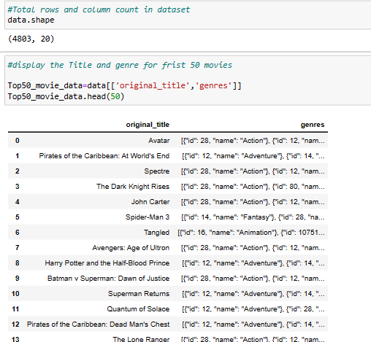
Task1: Load the movie dataset in the Python notebook. Display the numbers of rows and columns in the dataset. Display the titles and genres of the first 50 movies from the dataset.
Load the movie dataset in the Python.
Numbers of rows and
Columns are (4803,20)
The Titles and genres of the first 50movies Avatar at top in action genre.

Slide 6

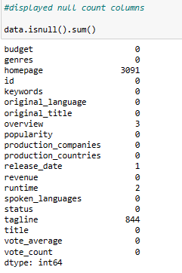
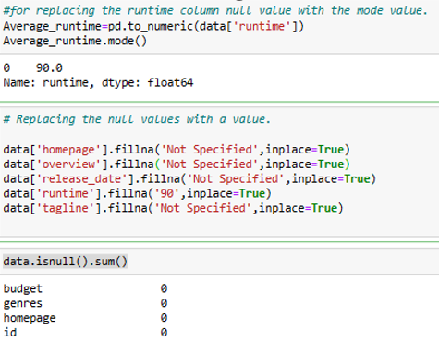
Task2: Identify the columns that have null values and perform the null value treatment. (Choose the imputation method based on the type of data in the columns of interest)
Total Null Value column is 5.
Replace the runtime null value with Mode value fillna function as it’s a numerical column.
The other column null value replaced by Not specified by using fillna function.

Slide 7
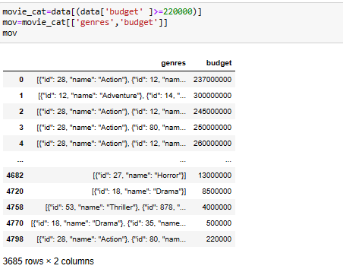
Task3:Display the movie categories that have a budget greater than $220,000
There are almost 3685 movies with budget greater then $22000 are mostly Action and adventure.

Slide 8

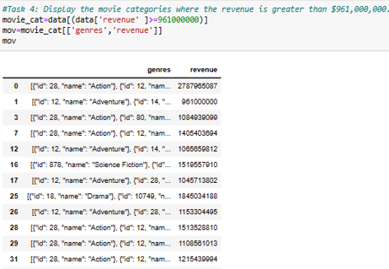
Task4: Display the movie categories where the revenue is greater than $961,000,000.
There are almost 24 movies with revenue greater then $961,000,000 and action ,adventure and animation are among top

Slide 9

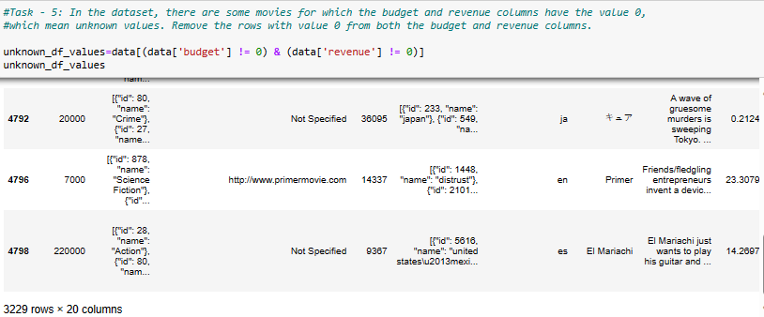
Task 5: In the dataset, there are some movies for which the budget and revenue columns have the value 0, which mean unknown values. Remove the rows with value 0 from both the budget and revenue columns.
There are almost 3229 movies without value 0 from both the budget and revenue columns.

Slide 10

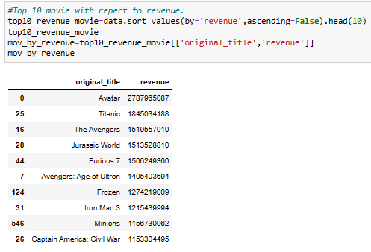
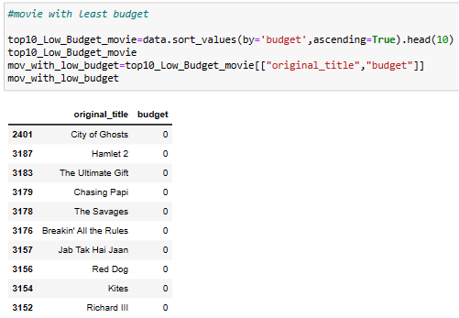
Task 6: List the top 10 movies with the highest revenues and the top 10 movies with the least budget.
Top 10 movies with the highest Revenues.
The Avatar movies has the highest revenue collection of almost $2787965087.
Top10 movies with the least budget.
The City of Ghosts and 9 movies has the least budget.

Slide 11
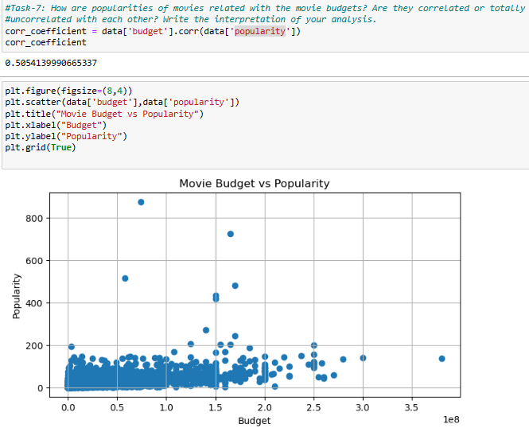
Task7: How are popularities of movies related with the movie budgets? Are they correlated or totally uncorrelated with each other? Write the interpretation of your analysis.
As the correlation coefficient is significantly positive (close to 1) and the scatter plot shows an upward trend, we can say that its a positive correlation between budgets and popularity.

Slide 12
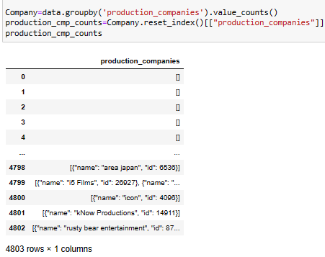
Task 8: Identify and display the names of all production companies along with the number of times they appear in the dataset.
So, there are almost 4803 production companies appeared in dataset.

Slide 13
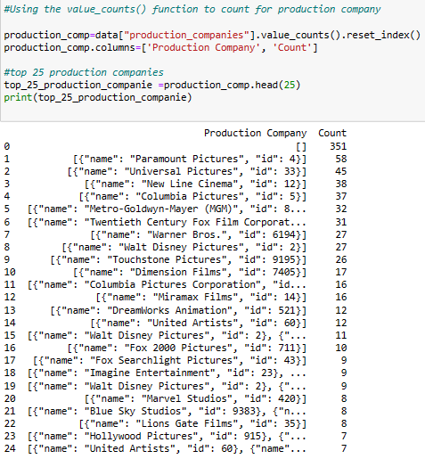
Task 9: Display the names of the top 25 production companies based on the number of movies they have produced in descending order of the number of movies produced.
Production companies paramount picture and universal pictures among top .

Slide 14

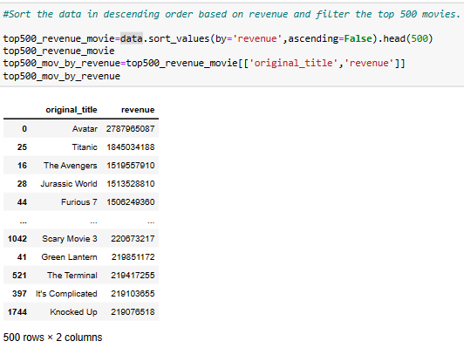
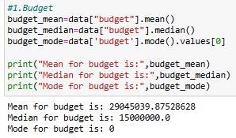
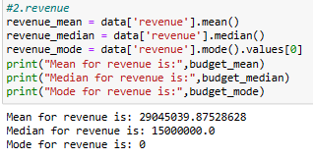
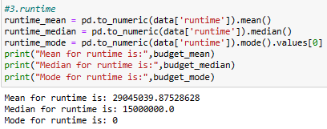
Task 10: Sort the data in descending order based on revenue and filter the top 500 movies. Find the measures of central tendency for the following columns using the filtered data:1. budget 2.revenue 3.runtime .Perform outlier analysis for the above three columns using box plots.
The Top 500 movies
measures of central tendency for the following columns using the filtered data:1. budget 2.revenue 3.runtime

Slide 15

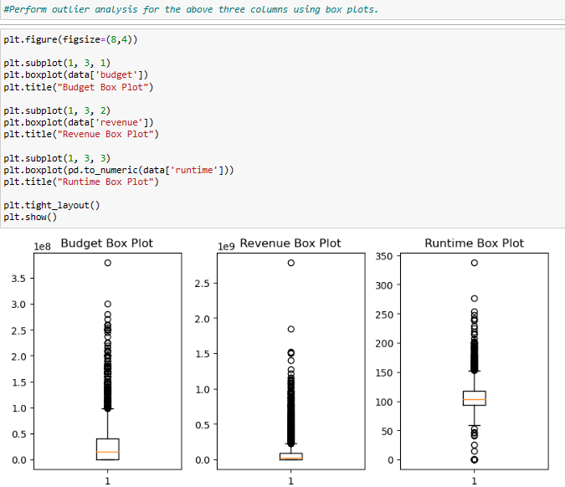
Task 10.3: Perform outlier analysis for the above three columns using box plots.
There are extreme outlier present in Budget box plot, revenue box plot & Run-Time boxplot.

Slide 16


Conclusion
Summary Highlights Key Information
Top Genre Movies:
Top Genre: Action and Adventure
Example Movies: "Avatar" and "Pirates of the Caribbean"
Movies with Budget Greater than $220,000:
Number of Movies: Approximately 3,685
Genre: Action and Adventure
Movies with Revenue Greater than $961,000,000:
Number of Movies: Approximately 24
Genres: Action, Adventure, and Animation
Movies with Non-Zero Budget and Revenue:
Number of Movies: Approximately 3,229
Top 10 Movies with the Highest Revenues:
Top Movie: "Avatar"
Revenue: Approximately $2,787,965,087
Top 10 Movies with the Lowest Budgets:
Examples: "The City of Ghosts" and 9 other movies have the lowest budgets.
Top 25 Production Companies:
Based on the Number of Movies Produced
Notable Companies: Paramount Pictures and Universal Pictures are among the top production companies.
This project shows how using data analysis can help the movie industry.
By looking at data closely, Movie-makers should consider following aspects to gain profitability:
Targeting Genre selection, budget allocation and revenue potential when planning their projects.
Learning from top-performing movies.
Collaborating with established production companies.
Careful management of budget and revenue.

Slide 17

Thank you
Vaibhav Sirohi Batch: DA92S9

